Slide 1
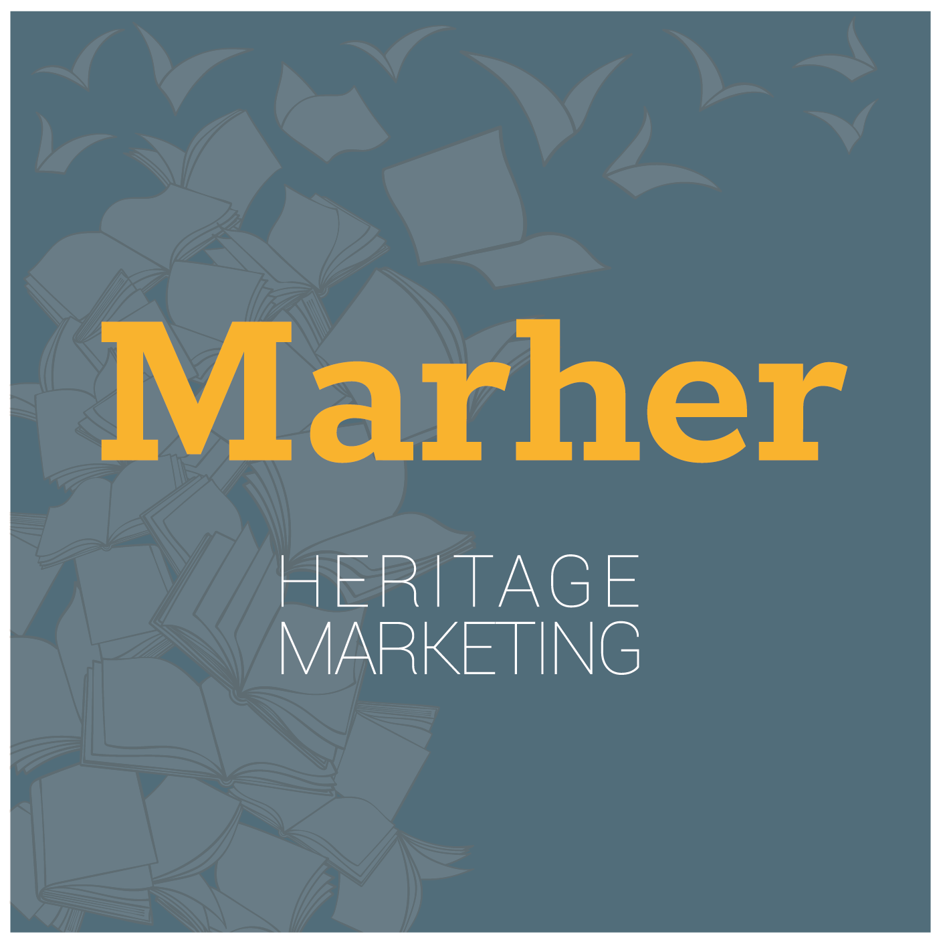
CHAPTER 5
First tool: Canvas for Heritage Marketing
MARHER - Heritage Marketing for competitiveness of Europe in the global market
Project Reference Number: 2019-1-DK01-KA202-060273
Key Action 2 - Cooperation for innovation and the exchange of good practices

Slide 2
What is a model canvas in business modeling and why is it a replicable system to identify heritage marketing needs?
The business model canvas is a great tool to help you understand a business model in a straightforward, structured way. Using a canvas will lead to insights about the customers you serve, what value propositions are offered through what channels, and how your company makes money. You can also use the business model canvas to understand your own business model or that of a competitor. The most famous business Model Canvas was created by Alexander Osterwalder but counts many different variations and evolutions.
The heritage marketing needs of a company can be structured in a similar way to the more business-related needs. For this reason, it was decided to reuse the logical mechanisms at the basis of the business model canvas to develop a collaborative tool that allows companies to identify their internal needs, once the decision to develop the heritage marketing product has been taken.
MARHER - Heritage Marketing for competitiveness of Europe in the global market
Project Reference Number: 2019-1-DK01-KA202-060273
Key Action 2 - Cooperation for innovation and the exchange of good practices

Slide 3
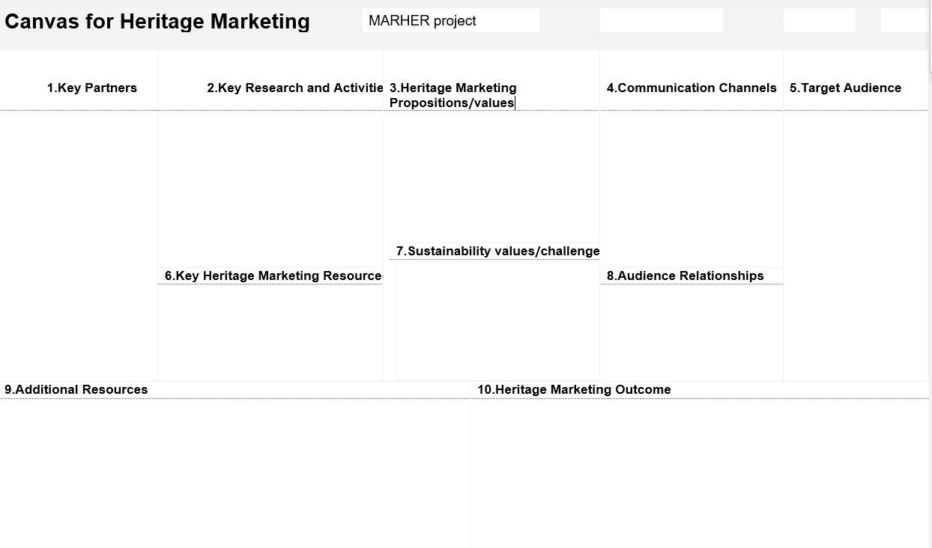
MARHER - Heritage Marketing for competitiveness of Europe in the global market
Project Reference Number: 2019-1-DK01-KA202-060273
Key Action 2 - Cooperation for innovation and the exchange of good practices

Slide 4
The canvas model offers two main advantages:
1) It is a tool that allows at the same time to brainstorm and share information throughout the team without having to organize specific moments for these two phases of creation and elaboration.
2) A structured model is a fluid system where different elements influence each other and should be taken into account at the same time to design a coherent structure. So, it is possible for a team to start from any section of the framework and then move on to other points. After completing the model, it is possible to rework each section toward a general coherence of the system.
MARHER - Heritage Marketing for competitiveness of Europe in the global market
Project Reference Number: 2019-1-DK01-KA202-060273
Key Action 2 - Cooperation for innovation and the exchange of good practices

Slide 5
These characteristics apply very well to the creation of a heritage marketing product. Of course, it will be necessary to replace the core elements of a business model with the fundamental points of a narrative structure, the elements that compose it, the people and skills involved, and the resources needed to finalize the storytelling product.
MARHER - Heritage Marketing for competitiveness of Europe in the global market
Project Reference Number: 2019-1-DK01-KA202-060273
Key Action 2 - Cooperation for innovation and the exchange of good practices

Slide 6
When looking at the structure of a Heritage Marketing Canvas, it should be noted that, although theoretically it is possible to start from any section and then readjust the work to make the system completely coherent, it is advisable to start having in mind what the heritage value proposition and the type of final product are.
MARHER - Heritage Marketing for competitiveness of Europe in the global market
Project Reference Number: 2019-1-DK01-KA202-060273
Key Action 2 - Cooperation for innovation and the exchange of good practices

Slide 7
Let ‘s see what the main elements of a Heritage Marketing Canvas are and how they can be described to improve the planning of a heritage marketing product.
MARHER - Heritage Marketing for competitiveness of Europe in the global market
Project Reference Number: 2019-1-DK01-KA202-060273
Key Action 2 - Cooperation for innovation and the exchange of good practices

Slide 8
1) Key partners
Key partners are the individual or collective subjects with technical competences (both intellectual and technical) with whom one has to relate to start the production process of the heritage marketing product. The professional heritage marketer, as a new European professional figure able to promote and communicate (inside and outside of the company to internal and external stakeholders) the history, identity and values of the companies organization through cultural heritage, Thus, heritage marketer should manage the entire process of elaboration and management of the production effort of a heritage marketing product. Key partners should also include institutional and non-institutional actors who will participate in the dissemination of the product itself.
MARHER - Heritage Marketing for competitiveness of Europe in the global market
Project Reference Number: 2019-1-DK01-KA202-060273
Key Action 2 - Cooperation for innovation and the exchange of good practices

Slide 9
2) Key research and activities
Research activities are at the basis of the production of the storytelling product. This type of activity encompasses all that concerns the research of documentary or audiovisual materials, the design of the structure of the object and the methods of physical production. Research activities are of course particularly linked to the nature of the heritage marketing product which will require different approaches (Examples: research in archives, interviews, script draft, etc.).
MARHER - Heritage Marketing for competitiveness of Europe in the global market
Project Reference Number: 2019-1-DK01-KA202-060273
Key Action 2 - Cooperation for innovation and the exchange of good practices

Slide 10
3) Heritage marketing proposition/value
We define Heritage Value Proposition as the set of values that the company wants to convey through the heritage marketing object being developed. The heritage marketer has to ask himself what value he wants to connect to the brand name or the specific product. What is the vision of the world that the company wants to transmit or even what values underlie its mission for the future (Strength of tradition, Capacity for innovation, Success from humble origins. etc.). The heritage value proposition is certainly a central element on which the whole narrative must pivot, otherwise it loses sight of its main objective, to have a relevant impact on an audience. Of course, also the audience types have to be taken into account when constructing a heritage value proposition and one will therefore have to pay attention to other sections of the canvas to correctly derive this information.
MARHER - Heritage Marketing for competitiveness of Europe in the global market
Project Reference Number: 2019-1-DK01-KA202-060273
Key Action 2 - Cooperation for innovation and the exchange of good practices

Slide 11
4) Communication channel:
Fundamental is the choice of media through which the heritage marketing product outlined in the canvas will be disseminated. In order to orientate this choice, decisions must be made based above all on the nature of the object (video, images, written in print, etc.) and the types of audience to be reached. Naturally, products based on film or video will have different distribution channels from those based on audio (such as podcast, for example) or printed publications. It is essential to pay attention to the type of audience to be reached with one's heritage marketing product, as has become clear today even with regard to social networks that have different users according to the demographic segment to be reached.
MARHER - Heritage Marketing for competitiveness of Europe in the global market
Project Reference Number: 2019-1-DK01-KA202-060273
Key Action 2 - Cooperation for innovation and the exchange of good practices

Slide 12
5) Target Audience
The target audience consists of the different groups of people we want to reach with our heritage marketing work. Of course, the choice of the audience influences and is influenced by the value proposition. Different targets should correspond to different value propositions. The target audience also depends on the objective of our heritage marketing product. For example, a heritage marketing product that wants to trigger internal change should be designed for employees and collaborators while a product designed to promote a service will be different from one designed to interest a group of investors.
MARHER - Heritage Marketing for competitiveness of Europe in the global market
Project Reference Number: 2019-1-DK01-KA202-060273
Key Action 2 - Cooperation for innovation and the exchange of good practices

Slide 13
6) Key heritage marketing resources
The resources that are necessary to create value for the heritage marketing. They are considered assets to a company that are needed to sustain and support the business. These resources could be different ones, such as human, financial, physical and intellectual, letting to connect and transform the past to the future.
MARHER - Heritage Marketing for competitiveness of Europe in the global market
Project Reference Number: 2019-1-DK01-KA202-060273
Key Action 2 - Cooperation for innovation and the exchange of good practices

Slide 14
7) Sustainability values/challenges
When thinking about heritage marketing and sustainability, sustainability here should be understood as effective management of resources for the benefit of future generations. Thus, when thinking about the sustainablity values, we should emphasize on the fostering sustainability increasing social capital, ensuring environmental sustainability. When developing heritage marketing processes and products, we should try to seek ensure inclusive and sustainable development.
MARHER - Heritage Marketing for competitiveness of Europe in the global market
Project Reference Number: 2019-1-DK01-KA202-060273
Key Action 2 - Cooperation for innovation and the exchange of good practices

Slide 15
8) Audience Relationship
The Audience Relationship is the type of relationship you want to establish with your target audience, also based on the feeling/reaction/type of activation you want to arouse in the groups of people you want to stimulate with your narrative.
The relationship must be two-way and is closely related to the type of emotional content in the heritage value proposition. Of course, it is necessary to identify expectations of relationship with the audience appropriate to the type of target audience, as well as to understand the most suitable communication channels to convey an effective connection with the audience.
MARHER - Heritage Marketing for competitiveness of Europe in the global market
Project Reference Number: 2019-1-DK01-KA202-060273
Key Action 2 - Cooperation for innovation and the exchange of good practices

Slide 16
9) Heritage Marketing Outcome
The final heritage marketing product describes the final object of the heritage marketing process.
MARHER - Heritage Marketing for competitiveness of Europe in the global market
Project Reference Number: 2019-1-DK01-KA202-060273
Key Action 2 - Cooperation for innovation and the exchange of good practices

Slide 17
10) Additional resources
Additional resources are any kind of tangible or intangible resource useful to achieve the Heritage Marketing Outcome. Additional resources are related to the all of key elements of the process, and can be collected and cataloged from sources outside the company (institutional sources, journalistic sources etc.). They are necessary to enrich the story with external elements that do not necessarily come from the history of the product or the company itself but help to define a historical, geographical and cultural context that enriches the heritage marketing product and facilitates its fruition.
MARHER - Heritage Marketing for competitiveness of Europe in the global market
Project Reference Number: 2019-1-DK01-KA202-060273
Key Action 2 - Cooperation for innovation and the exchange of good practices

